Slide 1

Flask Deployment
Predicting NBA salaries based on statistics
Submitted by Anthony Sanogo
28 January 2023

Slide 2
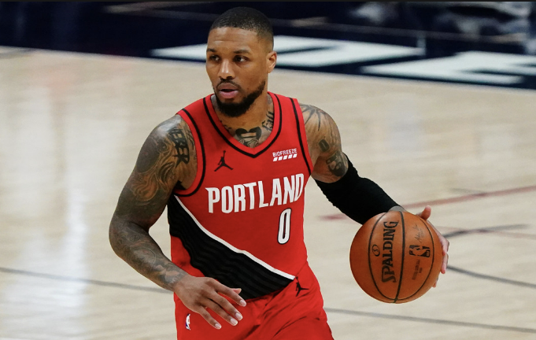

Executive Summary
OBJECTIVE: Provide actionable insights to help NBA players ask for deserving salary based on their stats.

Slide 3
Agenda
Data Exploration
Model Creation
Writing Flask Application
HTML Template Creation & Styling
Running Flask Application

Slide 4
Data Exploration

Slide 5
Datasets Exploration
Below is the list of datasets used for the project:
nba_2020_stats.csv – this file contains every NBA player per game stat line for the 2019-2020 season
nba_2020_all_stars.csv – this file includes the names of the players that were deemed an All-Star for the 2019-2020 season
nba-salaries.csv – this file contains every NBA player per game salary for the 2019-2020 season
Data Exploration

Slide 6
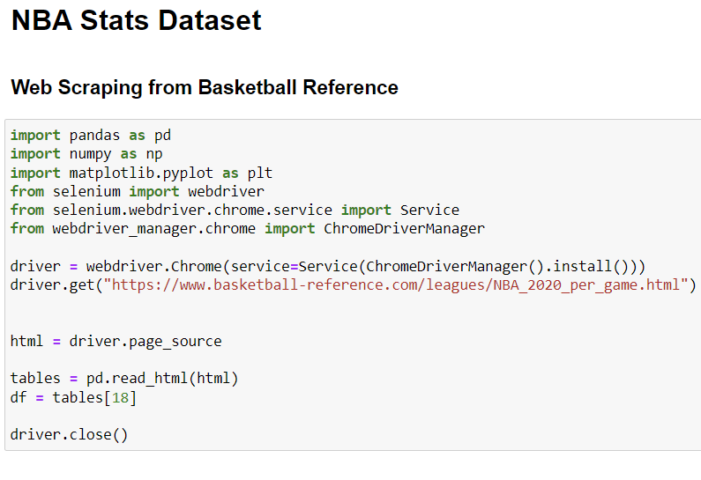
Datasets Exploration
I used web scraping to get every player's stat line for the 2020 season.
Stats file

Slide 7
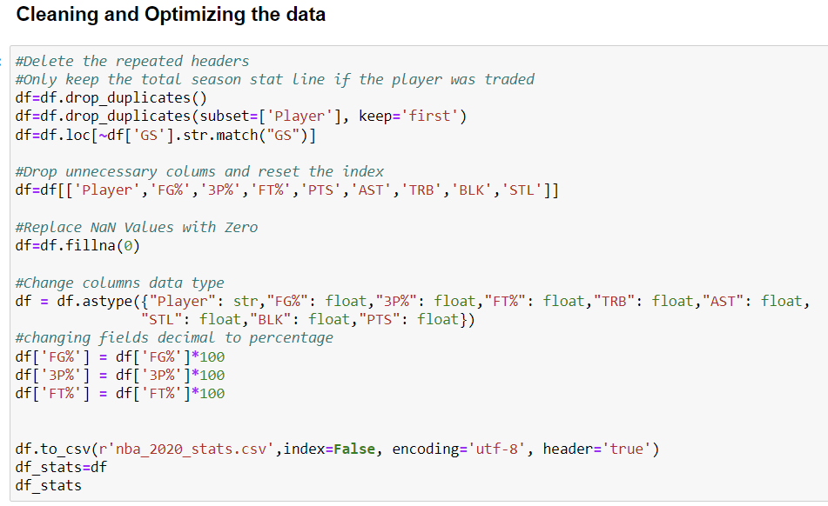
Datasets Exploration
Stats file (continue)

Slide 8
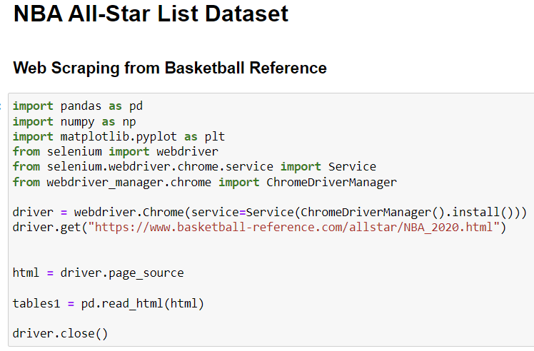
Datasets Exploration
I used web scraping to get the name of the players selected to be an All-Star for the 2020 season.
All Star file

Slide 9
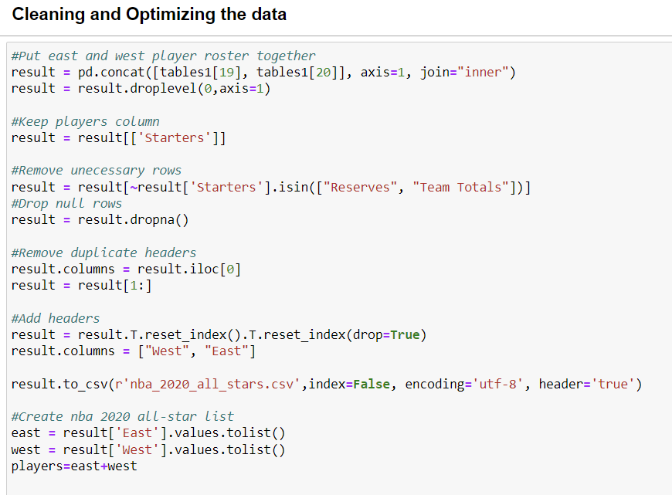
Datasets Exploration
All Star file
(continue)

Slide 10
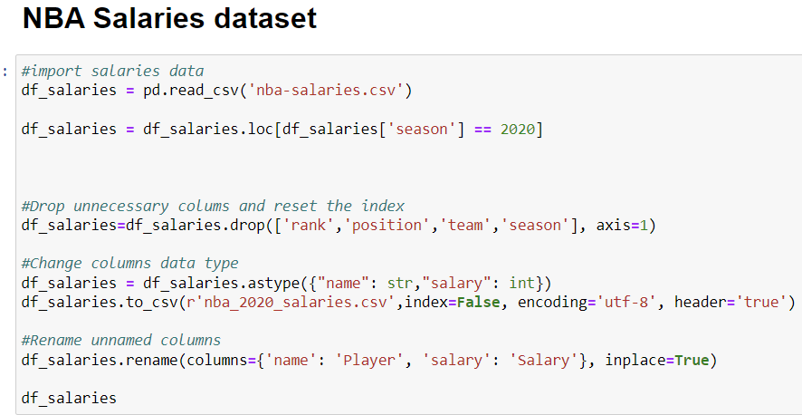
Datasets Exploration
The NBA salaries dataset was available on GitHub
Salaries

Slide 11
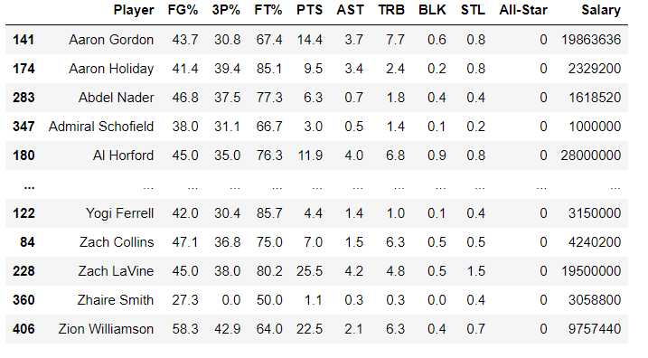
Final data after merge

Slide 12
Model Creation

Slide 13
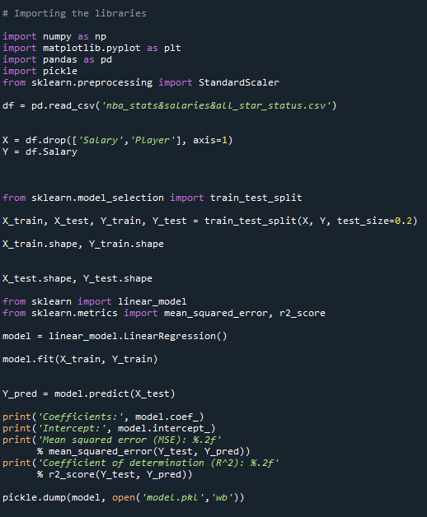
Model Creation

Slide 14
Writing Flask Application

Slide 15
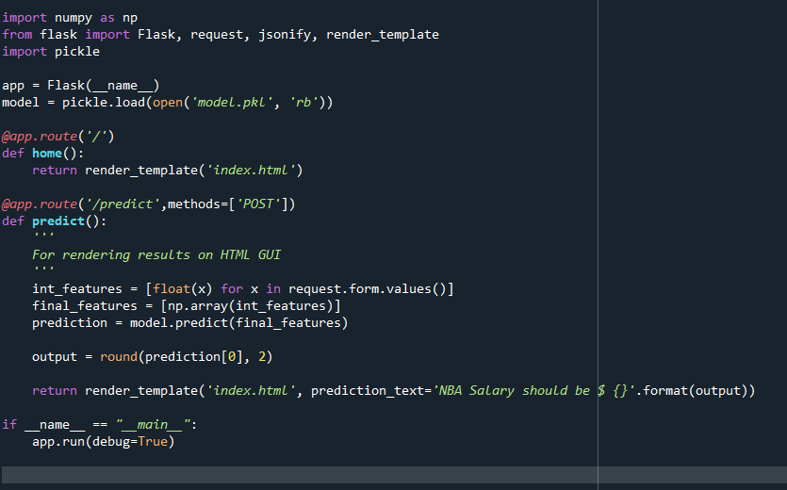
Writing Flask Application

Slide 16
HTML Template Creation & Styling

Slide 17
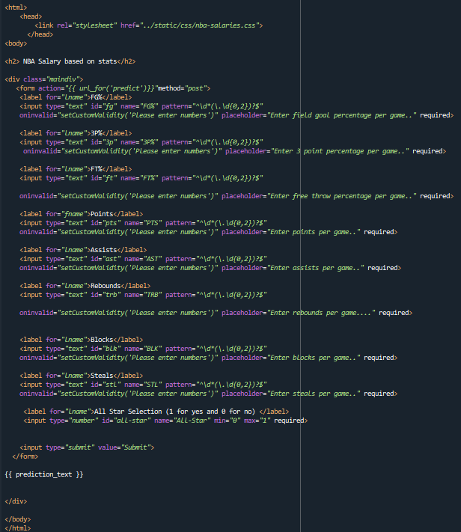
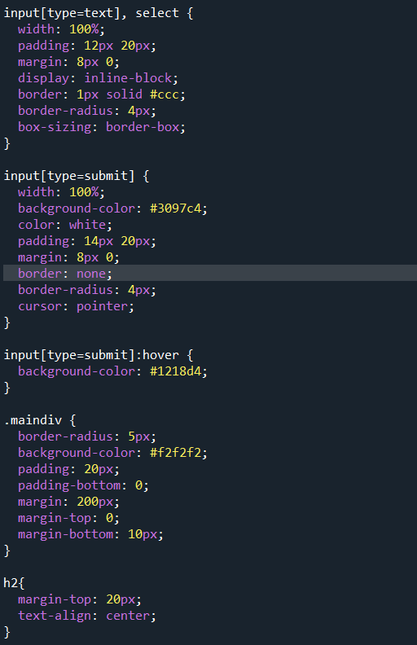
HTML Template Creation & Styling

Slide 18
Running Flask Application

Slide 19
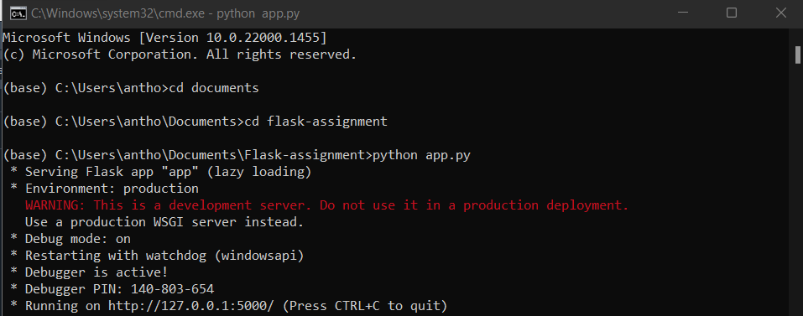
Running Flask Application

Slide 20
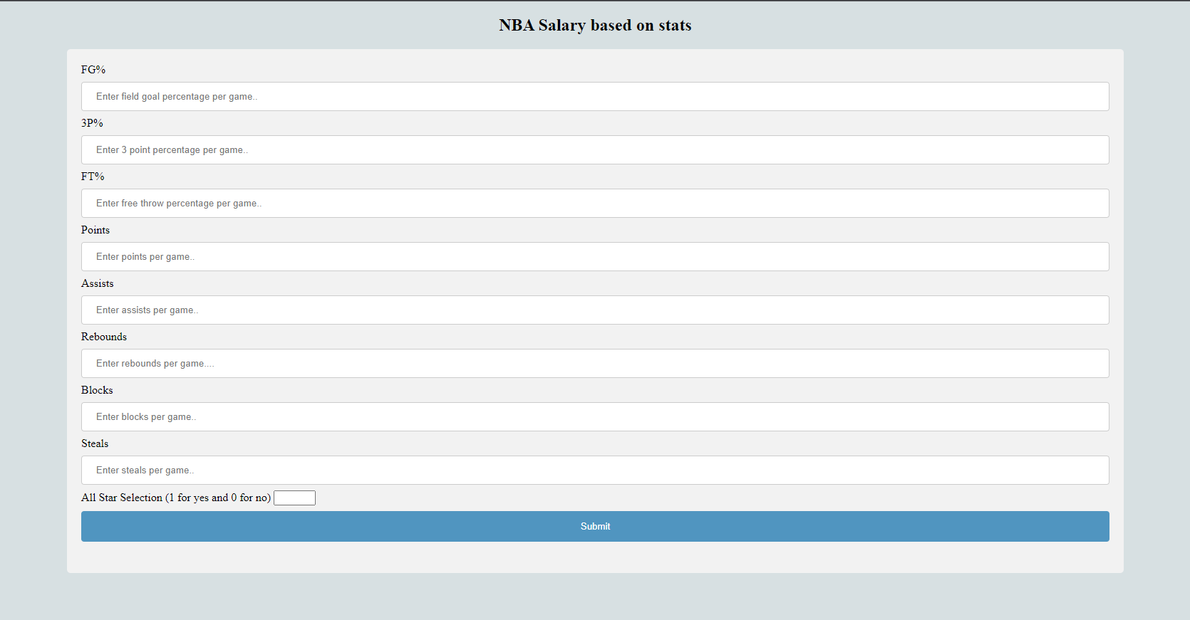
Open the link in the browser

Slide 21
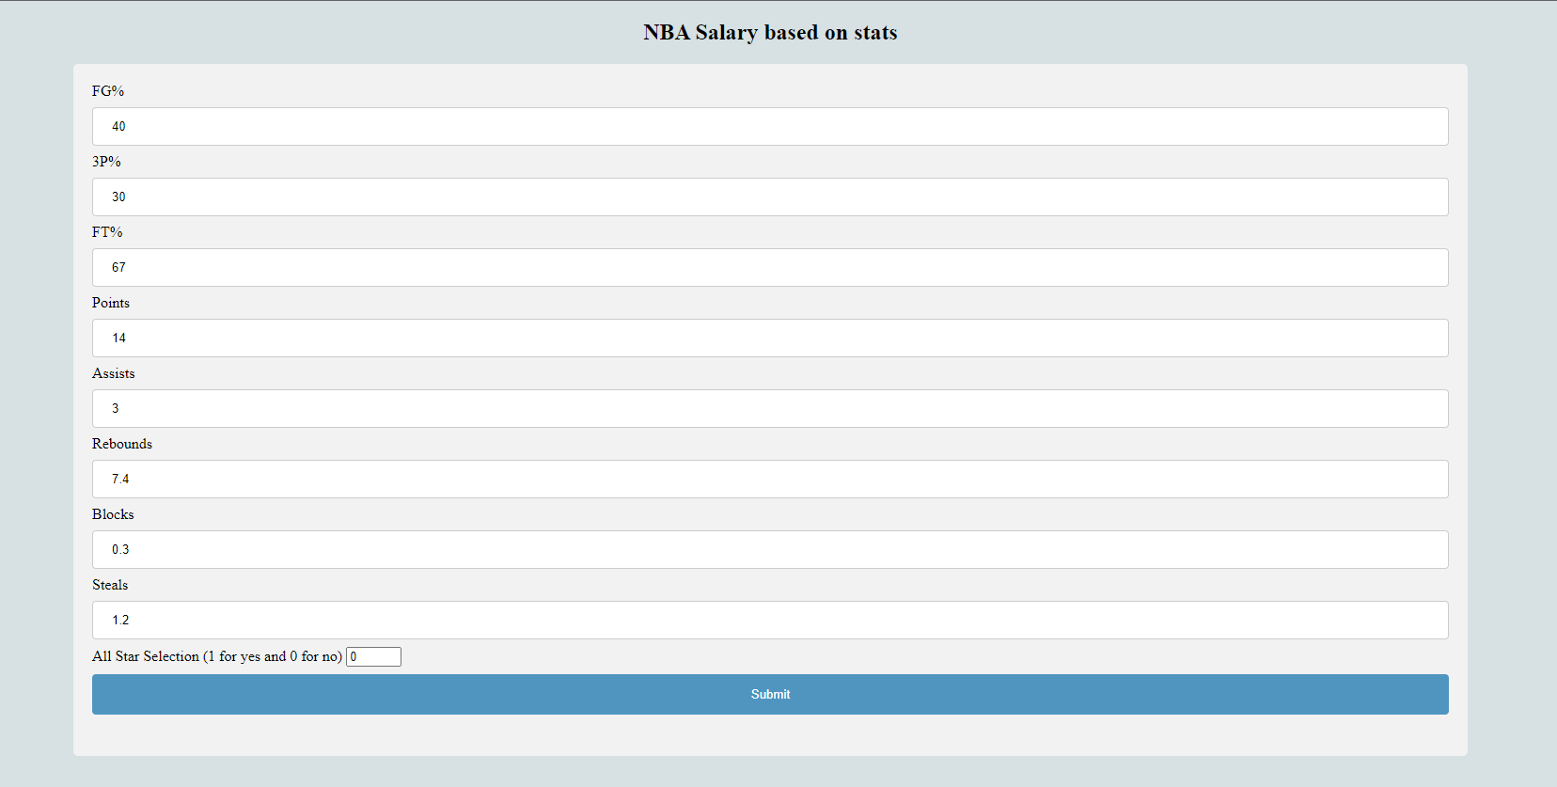
Filling out form

Slide 22
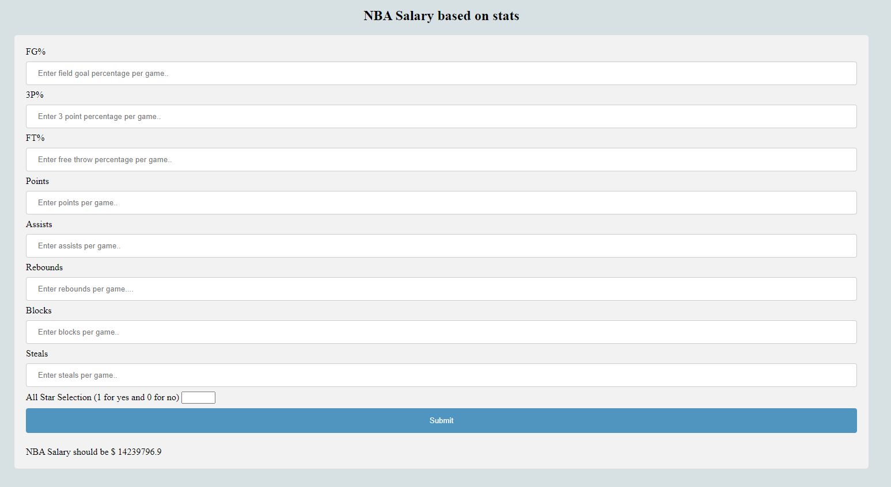
Get NBA salary

